Slide 1
C# - Where do you want to deploy today?
Jarred capellman

Slide 2
C#???
Creation lead by Anders Hejlsberg in 1999
Trivia: Original name was “C-like Object Oriented Language” (COOL)
Built on the CLR
Also on the CLR: F#, IronPython, C++/CLI and Visual Basic.NET

Slide 3
What Can You Do with C#?
Web Applications and Web Services
Desktop applications
Windows, Linux (via GTK#) and Mac OS X
Mobile Applications
iOS, Android and Windows
IoT Applications
Windows 10 IoT
Games
MonoGame
Notes:
https://www.uspto.gov/patents-getting-started/general-information-concerning-patents#heading-4

Slide 4
Key Components

Slide 5
NuGet
Packages (think npm)
Most components from Microsoft are released via NuGet as opposed to longer periods between .NET Framework updates
Commonly used NuGet packages:
Newtonsoft.Json (JSON Serialization/Deserialization Library)
EntityFramework (Microsoft’s ORM)
StackExchange.Redis (My favorite Redis client)

Slide 6
LinQ
Querying syntax to provide a SQL-like experience with arrays, collections etc.
Examples:
var people = peopleCollection.Where(a => a.Age > 18 && a.Name == “John”).ToList() // Builds a List<People>
var person = peopleCollection.FirstOrDefault(a => a.Name == “John”); // Returns null or a single People object
var convertedPeople = peopleCollection.Where(a => a.Age > 18).Select(b => new NewPerson(b.Name)).ToList(); // Returns a List<NewPerson>
var namesOnly = peopleCollection.Select(a => a.Name).ToList() // Builds a List<string>

Slide 7
PLINQ
Parallelization Extension to LinQ
System.Collections.Concurrent and System.Collections.Immutable
Examples:
Parallel.ForEach(largeBatchOfUsers, user => {
// Some thread safe operation
});
var totalExperience = employeesExperience.AsParallel().Sum();

Slide 8
EntityFramework/EntityFramework Core
Allows a code first or database first method
Interfaces between SQL Server, SQLite, MySQL, Oracle and Postgres to name a few
Database First Method
Generates Partial Classes for Tables, SQL Views, Stored Procedures
Code First
Write classes and then apply migrations (similar to Django models)
All strongly typed
Table Query Example:
using (var eFactory = new EntityFactory()) {
return eFactory.Users.Where(a => a.Active).ToList();
}
Stored Procedure Example:
using (var eFactory = new EntityFactory()) {
return eFactory.GetActiveUsersSP(“John”).ToList();
}

Slide 9
XAML
XML like language
Used for Xamarin, WPF and Universal Windows Projects
MVVM use is critical to be successful with more than a simple Hello World type application!
Example:
<Grid>
<Grid.RowDefinitions>
<Grid.RowDefinition Width=“Auto” />
<Grid.RowDefinition Width=“*” />
</Grid.RowDefinitions>
<TextBlock Grid.Row=“0” Text=“Hello” />
<TextBlock Grid.Row=“1” Text=“{Binding Name}” />
</Grid>

Slide 10
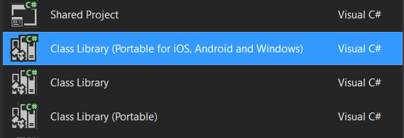

Class Library, Portable Class Library, .NET Standard Library?

Slide 11
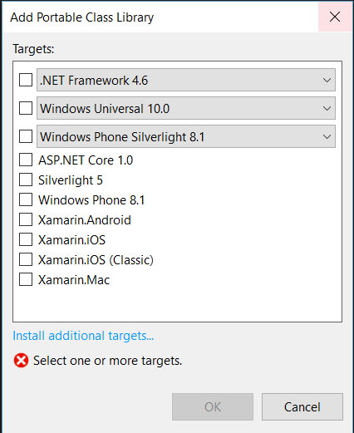
Portable Class Library?

Slide 12
.NET Standard Breakdown

Slide 13
.NET Native (NGEN with a Turbo)
Only on Universal Windows Projects
Typical path:
C# -> JIT -> IL
.NET Native path:
C# -> IL -> Native
Common Issues:
Reflection
Serialization/Deserialization

Slide 14
Platforms, Frameworks and Devices oh my…

Slide 15
Web Applications
Two frameworks: ASP.NET WebForms and ASP.NET MVC
WebForms:
Older, but quicker to jump into
Structure:
ASPX – Contains your CSS/JS/HTML/Server Controls
ASPX.CS – Code behind for the page itself
MVC
Newer, more time to get up and running
Mobile and Device specific views as simple as: Index.mobile.cshtml
Structure:
Controller – C# class
Model – C# object
CSHTML – Razor views with HTML/CSS/JS and MVC Helpers

Slide 16
Web Services
Two frameworks: WCF and WebAPI
WCF:
Older, SOAP based framework – lots of configuration needed
Fun fact: WCF <-> WCF communication auto negotiates to a binary transmission instead of XML
WebAPI:
Newer, REST based framework
Automatic JSON serialization/deserialization support
Can be embedded within an MVC application

Slide 17
Desktop Applications
Three frameworks: WinForms, WPF and UWP
WinForms
Oldest – drag and drop UI designer, code behind structure similar to WebForms
WPF
“Replacement” for WinForms, uses XAML
UWP
Combines a lot of WPF elements such as XAML and overall program structures
Main Objective: One binary for Windows 10 desktop, phone, HoloLens, IoT and Xbox One
Access to a lot of APIs and uses the same controls that Windows 10 itself uses

Slide 18
Games
Three major frameworks: MonoGame, SharpDX and Unity
MonoGame (XNA)
Great for 2D games in particular, supports iOS, Android, Windows Desktop/Phone, Mac OS X, Linux, Xbox One
SharpDX
Managed wrapper of the C++ dlls providing a C#-like DirectX 9-12+ programming experience
Deployable to Windows 7 and UWP Platforms
Unity
Based on .NET 3.5
Quick to get up and running

Slide 19
IoT
Two approaches: Windows 10 IoT Core and Linux
Windows 10 IoT Core:
RPI 2/3 (ARM), DragonBoard (ARM), MinnowBoard (x86)
Free!
Deploy and debug straight from Visual Studio
UI is done through XAML
Built in Web Server to manage installed apps and set startup apps

Slide 20
Mobile Applications (Xamarin)
Two paths: “Classic” or “Forms”
Classic:
More bare metal experience on iOS and Android
Less portability of code (UI on iOS is through the Xcode Interface Builder for instance)
Namespaces are identical to their Objective-C and Java counterparts (NS* for iOS)
Easier/More control over UI
Forms
One codebase for iOS, Android, UWP
Barebones XAML syntax
Structure:
One shared project with UI and Business Logic
One project per platform that references the shared project
Any platform specific implementations as well

Slide 21
Good Resources to keep learning…
Channel 9 (https://channel9.msdn.com)
Microsoft Virtual Academy (https://mva.microsoft.com)
My GitHub (https://github.com/jcapellman)
Xamarin Guides (https://developer.xamarin.com/guides/)
Windows Developer (https://developer.microsoft.com)
Jumping into UWP Dev on your Xbox One (https://developer.microsoft.com/en-us/windows/apps/uwp-on-xbox)
Windows 10 IoT (https://developer.microsoft.com/en-us/windows/iot)
GrovePi IoT Library (https://github.com/WillEastbury/GrovePi)

